Slide 1
Program Documentation
Computer Programming I

Slide 2
Objective/Essential Standard
Essential Standard: 2.00-Understand the Solution Development Process
Indicator: 2.03 Understand Proper Program Documentation, Code Comments, Use Cases, and Requirements Definition (3%)

Slide 3
Documentation
Why is it important?
Without proper documentation programs do not make sense, especially if you return to them later.
Or worse yet, you inherit a program from someone else and have to figure out what it does!

Slide 4
Complexity
As a program become more complex documentation becomes more important.
A program might be 100,000 lines of code. How would you remember what every single line does?
Windows for example is 40,000,000 lines of code!

Slide 5
Comments
In programming documenting your code is referred to as commenting.
Comments can be on their own line or after a line of code.
Comments begin with a ' .
Comments will turn the text green.
Notes:
Multiline comments are not supported in VB. Each line of the comment must begin with a ' .

Slide 6
Comment Examples
Line comments Do While i < intGradeNum 'while counter is less than number of grades entered run loop
Multi-line or Block Comments 'Student Name ‘Name of Program ‘Class Name ‘Date
Notes:
In Visual Studio comments appear in light green text. This text might not show up on all projectors, so all PowerPoints in this course will use red text for commenting.

Slide 7
Expectations
Some general rules:
Not every line should be commented, but any line that performs an operation should.
Any line that cause confusion should be commented.
At the top of the program there should be comments on its purpose and scope of the program.
Another common comment is a last revised date and version number at the top of the program.

Slide 8
Functional Requirements
Functional requirements are
the functions that the software/system is intended to perform.
what the software should do (behaviors) given conditions.
Use Cases have quickly become a widespread practice for capturing functional requirements. (http://www.bredemeyer.com/pdf_files/functreq.pdf)
Example:
If the user clicks on this button, a picture will be displayed and the name of the player will be shown in a new window.

Slide 9
Use Cases
Define the interactions between the “actor” and the system.
Actor = class of users, roles users play, or other systems.
In other words, the actor is any user of the system.
The Use Case describes the sequence of steps between the actor (user) and the system necessary to complete a goal.
http://www.bredemeyer.com/use_cases.htm#Use Cases

Slide 10
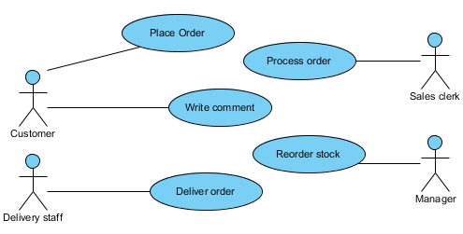
Use Case Example

Slide 11
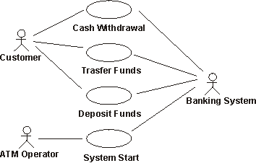
Use Case Example: Banking System

Slide 12
Use Cases
A Use Case also includes the alternate ways to complete a goal.
Use cases are written in easy to understand language so that users can understand and follow directions.
User Manuals are a great example.

Slide 13
Wrap Up
This lesson detailed program documentation, use cases and functional requirements and why they are important.
Remember to always comment your programs!

